Slide 1
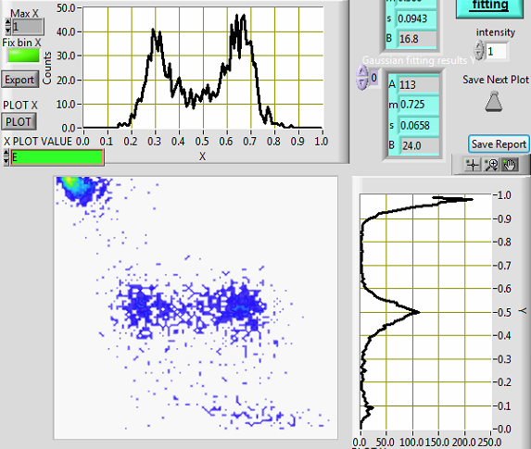
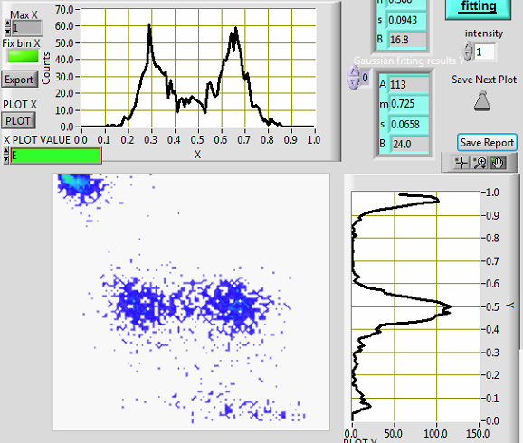
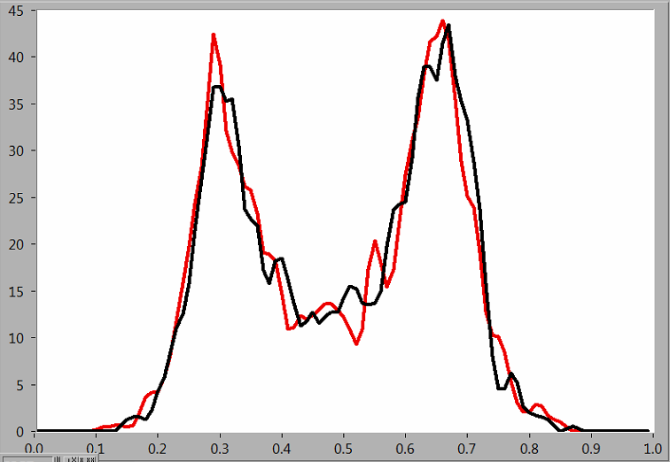
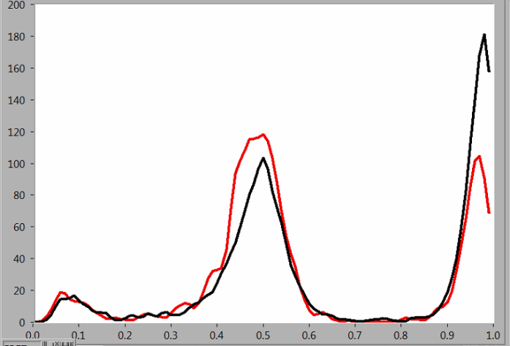
Stoichiometry:
R:H_donor:X:B_acceptor ->1.5X:1X:1.5X:1.5X
Hadas ran 12.5 pMolar in HPLC and collected peak 43.5 min
Same sample After HPLC clean,
peak 43.5 min
REFERENCE, After annealing in 250 nM
FRET
ALEX

